Slide 1

Heidelberg Road Corridor Planning
Engagement Session
Notes:
Insert council logo

Slide 2
Acknowledgement of Country
Darebin City Council acknowledges the Wurundjeri WoiWurrung people as the Traditional Owners and custodians of the land we now call Darebin and pays respect to their Elders, past, present and emerging. Council pays respect to all other Aboriginal and Torres Strait Islander communities in Darebin.
Council recognises, and pays tribute to, the diverse culture, resilience and heritage of Aboriginal and Torres Strait Islander people.
We acknowledge the leadership of Aboriginal and Torres Strait Islander communities and the right to self-determination in the spirit of mutual understanding and respect this ongoing contribution and its significant value.

Slide 3



Purpose of tonight’s session
This session will provide detailed information on the proposed planning response for the Heidelberg Rd Corridor.
It will give provide information on the context and reasons for these proposed planning changes.
Interested community members will have an opportunity to:
  Understand the changes
  Ask questions to clarify what it being proposed.
  Engage with Council planners about the changes.

Slide 4




Ground rules
Please ensure your microphone is on mute unless you are speaking. This is to avoid unnecessary background noise. The Chair may also mute participants microphones during the introductory remarks and presentations.
The Chair will let you all know when it is time to commence the meeting. It is the Chair’s role to facilitate the meeting, this means inviting people to talk at different times and allowing space for questions and conversations in line with the agenda.
Be considerate of others. Please ask a question using the “Chat” function and we will come to your question at the end of that agenda item.
Please give the meeting your full attention and leave your camera on, as you would in an in-person meeting. It can be tempting to multi-task, but this can result in missing important information.

Slide 5
Agenda
01
Acknowledgement of Country
(2 minute)
02
Running of the Session
(10 minute)
Tell us about yourself…
(10 minute)
03
04
Council Presentation: Proposed Planning Response
(20 minute)
05
    Wrap Up and Next Steps
    (5 minutes)
06
    Question Time
    (Approx. 20- 30 minutes)

Slide 6

Tell us about yourself…

Slide 7
Council Presentation

Slide 8

2021 National NAIDOC logo

Slide 9
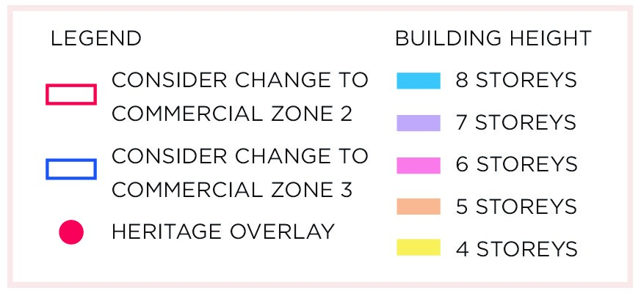
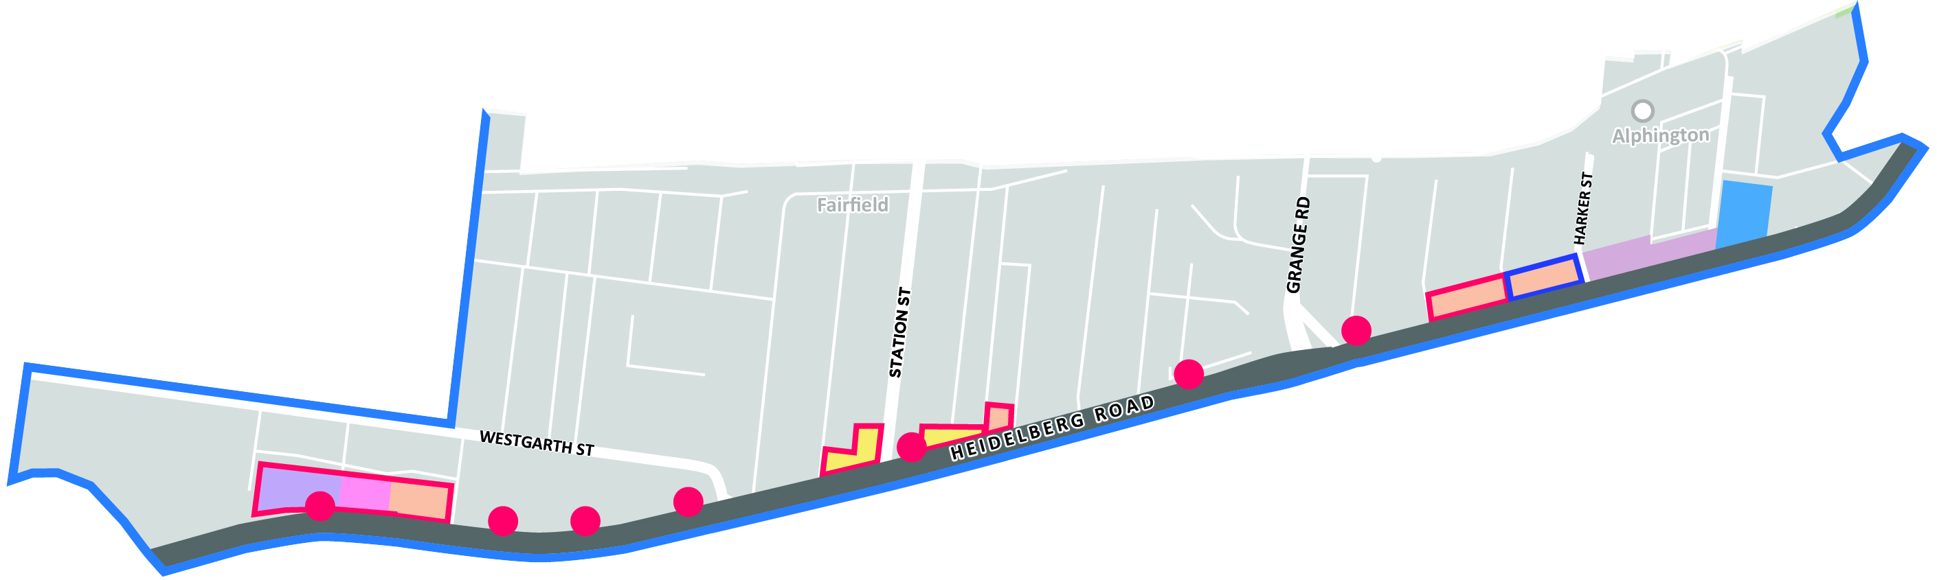
Heidelberg Road Corridor Project Study Area

Slide 10





Project Context
The redevelopment of the Alphington Paper Mill site (APM) will transform the area
There will be a change in the businesses attracted to Heidelberg Road
Currently there are no building height or design guidelines
for the area
Darebin and Yarra Councils have developed a vision for the area and a Local Area Plan (LAP)
Planning/ building design controls will be needed to realise this vision
These controls will need to be included in the planning scheme

Slide 11
Timeline
Darebin undertakes technical studies of the north side of Heidelberg Road.
Mid 2022 Darebin consults (exhibition)
of proposed planning scheme amendment.
Late 2021 - Darebin considers community feedback.
Redevelopment of APM site commences.
2018
2019
2020
2021
2022
Darebin and Yarra Councils undertake an analysis of Heidelberg Road and prepare a Local Area Plan (LAP).
May – August 2021 – Darebin seeks feedback on the Planning approach (north side only).
Early 2022 – Darebin prepares planning scheme amendment.
Notes:
- Again won’t go through this in detail – here is a bit of a snapshot of what has happened the last three years and what the next steps will be

Slide 12
Draft vision Statement
The overall vision for the Heidelberg Corridor is to be:
“greener, better connected, more pedestrian friendly and a vibrant place”
Notes:
- This is the vision for the corridor

Slide 13
Diverse Economic Activity
Community Wellbeing
Attract a wide range of businesses now and into the future
Ensure employment generating land uses are attracted to and retained within the Corridor.
Support locating community services closer to their likely area of need.
Increasing housing diversity and affordability along the Corridor.
Pursue new green space opportunities north of Heidelberg Road.
Draft Key Strategic Directions
Improved Active Transport Services and Accessibility
Distinct Precinct Identity
Improve public transport access, service frequency and coverage, to and along Heidelberg Road.
Increase connections for pedestrians and cyclists.
Minimise pressure on parking in residential areas behind Heidelberg Road.
Reduce or limit vehicle crossovers.
Create a more pedestrian oriented, attractive and safe public realm.
Ensure new development is sensitive towards existing residential uses.
Ensure public realm achieves a strong place identity.

Slide 14


Proposed Planning Response
Support More Local Jobs -
Economics and Land Use Study
Introduce Building Guidance and Controls - Built Form Framework
Protect Local Heritage - Heritage Study
Option to rezone industrial land to commercial zoning.
Option to introduce building height and overshadowing controls..
Option to protect heritage buildings through a heritage overlay.
Notes:
So in response to the LAP and background work, we have three main areas we’re focusing on – employment, built form and heritage – and I’ll talk through each of these now.
We did a survey of what people were most interested in for this session and all of these scored highly, so we’ll touch on each

Slide 15
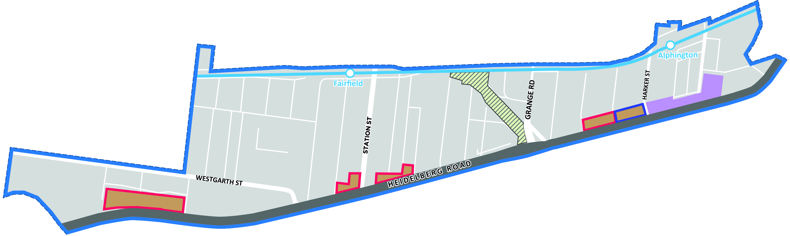
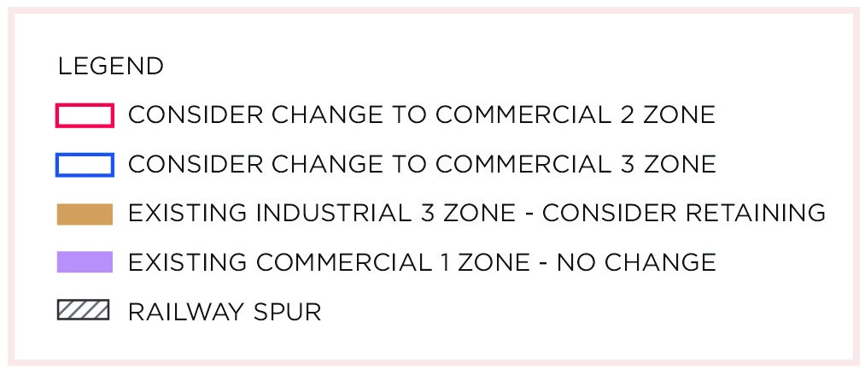
Support More Local Jobs - Economics and Land Use Study
Proposed zoning changes.

Slide 16
Economics and Land Use Study
 | Industrial 3 Zone (INZ3) – existing | Commercial 2 Zone (C2Z) – proposed | Commercial 3 Zone (C3Z) - proposed
Zone Objective | Provides for industries (warehouses, manufacturing) Limited retail opportunities Residential use prohibited | Encourages commercial areas for offices, some manufacturing/industries, commercial services Residential use prohibited | Provide for a range of industrial, commercial, office and employment generating uses ‘Collaborative and high-quality working environments’ Limited residential use permitted
Notes:
Key drive for the proposed change from Industrial 3 to Commercial 2 and 3 zone is that is allows a greater diversity of businesses in the corridor including emerging office accommodation, high tech warehouses and some manufacturing and industry. In Commercial 2 and 3 zones “offices uses are as of right” where the current Industrial 3 zone generally requires a planning permit. The Commercial 2 zone does not allow for residential uses therefore supports development of an employment precinct “ creating jobs” reflecting the growth in higher skilled workers living and working in Darebin. The Commercial zone is ear marked for the Fort Knox storage site given the size and existing capital improvements. The Commercial 3 zone is considered appropriate as it will still allow for industrial, commercial office and other employment generating options however allows limited residential uses. Hence its primary focus is still as an employment generating Zone Existing business uses on Heidelberg Road can continue to operate and the rezoning will result in rent increases.

Slide 17
Introduce Building Guidance and Controls
Improving design outcomes through mandated controls and assistance through the planning process.
This will provide a balance between supporting more jobs, protecting residential amenity and achieving better built form outcomes.
There are currently no design controls for Heidelberg Rd.
There are also planning restrictions which limit development floor space.

Slide 18
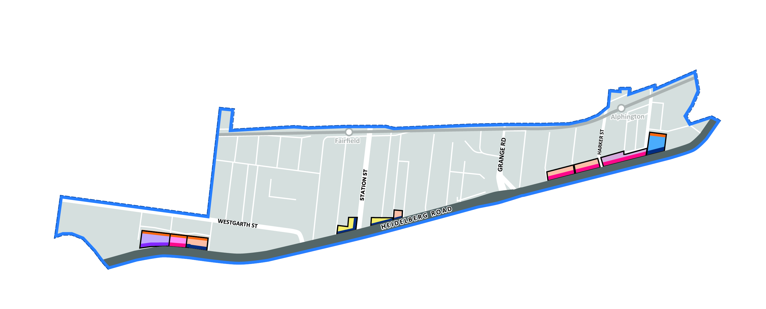

Introduce Building Guidance and Controls
Proposed building heights and street wall heights.

Slide 19
Building height of between 4 to 8 storeys proposed.
Precinct 1 has an overall building height of 6 storeys is recommended between Westfield and Jeffrey street.
  Building, street wall heights and overshadowing controls
  Side and rear setbacks to minimize visual bulk and maintain amenity of neighbouring dwellings and residential streets.

Slide 20
Precinct 2: Overall building height of 4 storeys is recommended due to shallow lot depth and to allow the Grandview Hotel to have prominence and act as a marker for Station street.
Notes:
Discretionary building height are being considered for the Heidelberg Road corridor rather than Mandatory heights. Discretionary building heights are a “preferred maximum height” and provide flexibility to vary heights based on an assessment of a buildings design and its impact to the amenity of its surrounds. Mandatory building heights are fixed therefore can provide certainty on the expectations however it can inhibit design it a set height rather then the best design ooutcome.

Slide 21
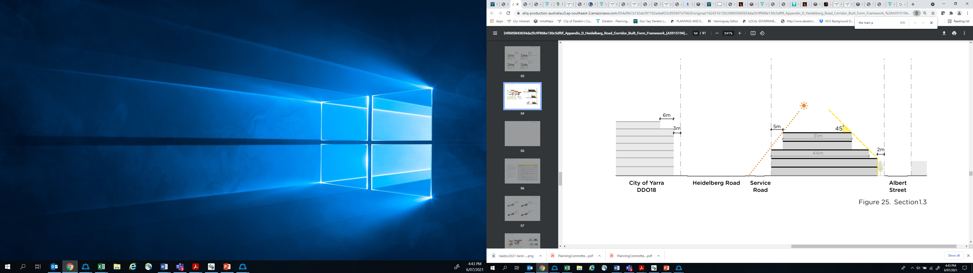
Street wall to residential properties

Slide 22
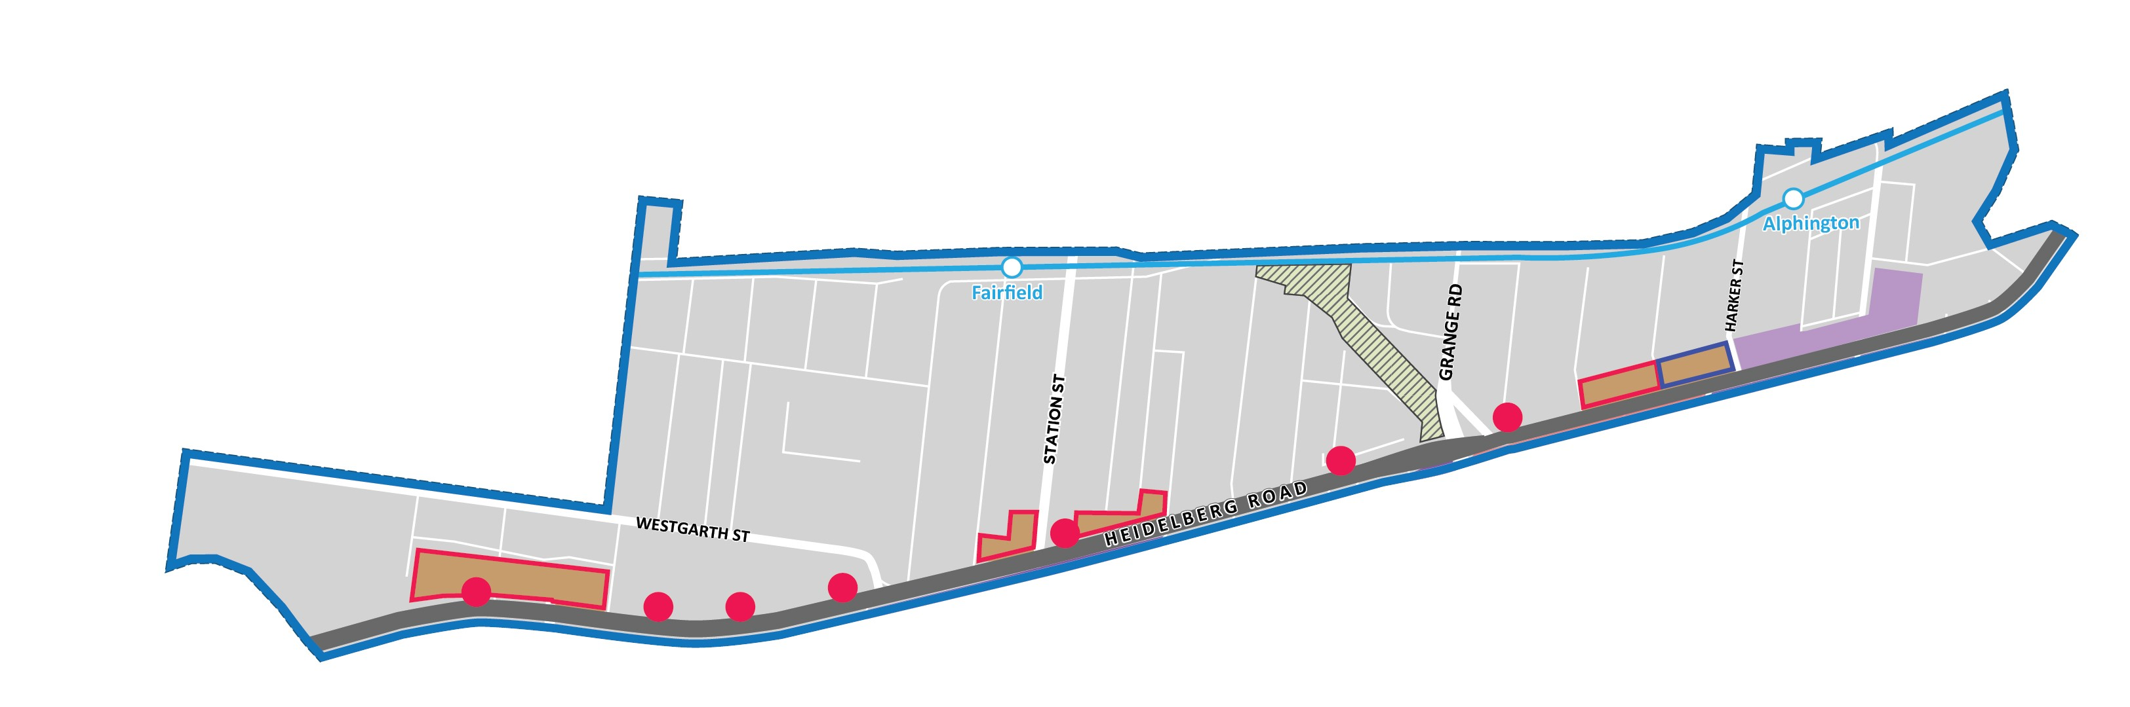
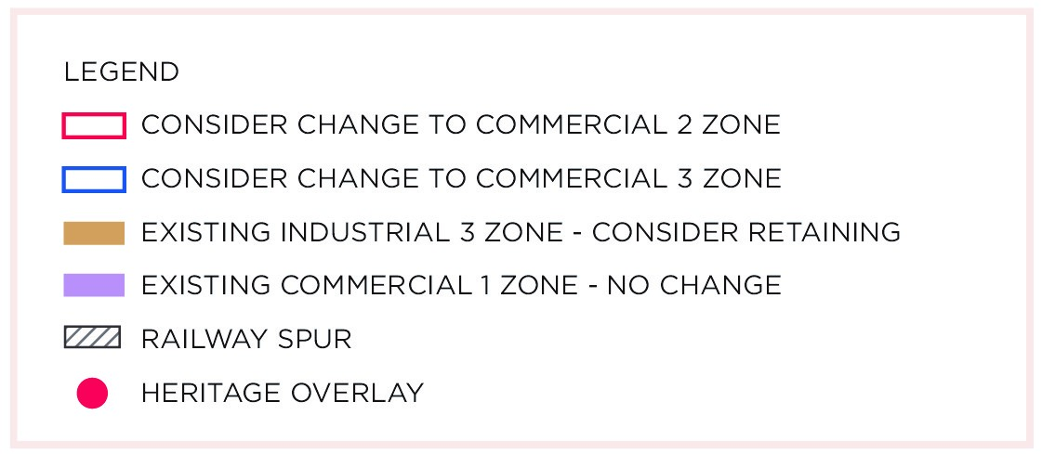
Protect Local Heritage – Heritage Study
Seven properties were identified as having local heritage significance.
Heritage Overlay is proposed to apply to them for their protection.

Slide 23
Process for identifying heritage properties
State government guidance
Analysis against similar examples in council area/state
Properties must meet specific criteria
Community consultation and feedback

Slide 24
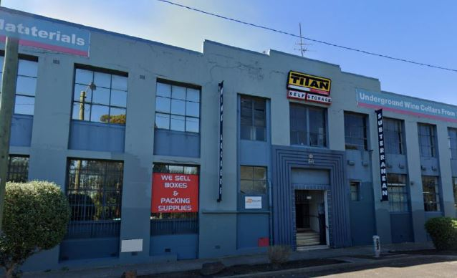
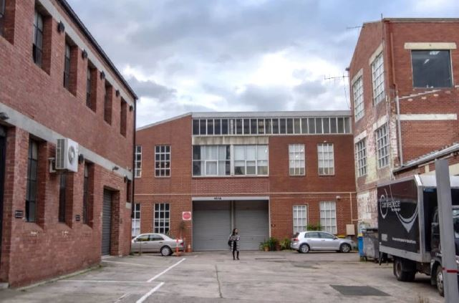
Former hat mill complex at 159-179 Heidelberg Road, Northcote
159-179 Heidelberg Road, Northcote.
View into the site from Heidelberg Road.

Slide 25
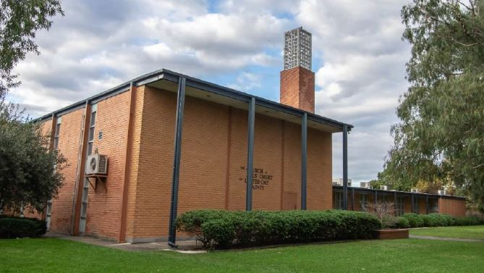
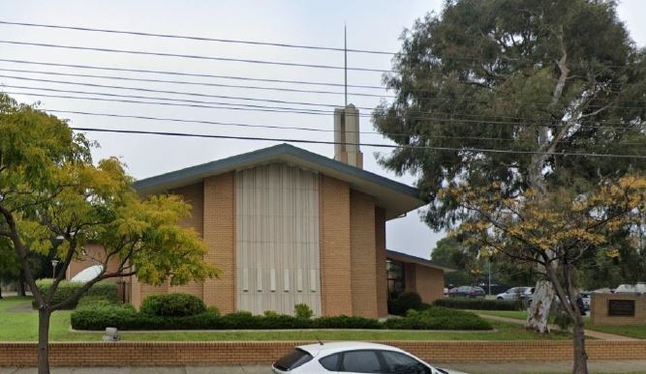
Church at 273-289 Heidelberg Road, Northcote
Quadrangle fronting Heidelberg Street, Northcote.
Chapel fronting Westgarth Street, Northcote.

Slide 26
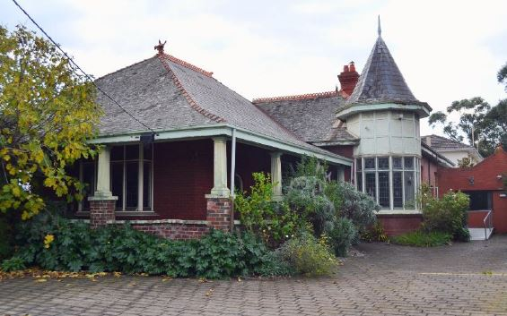
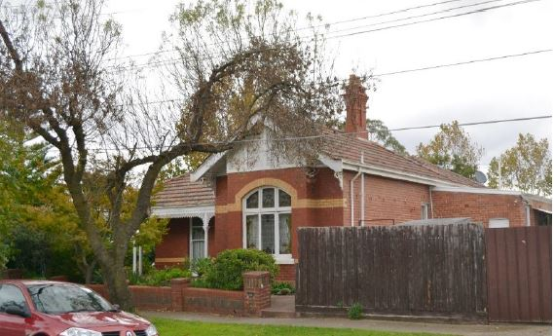
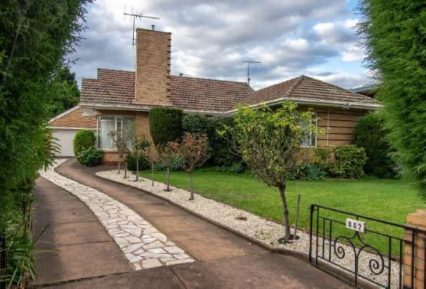
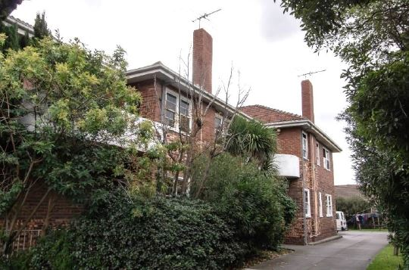
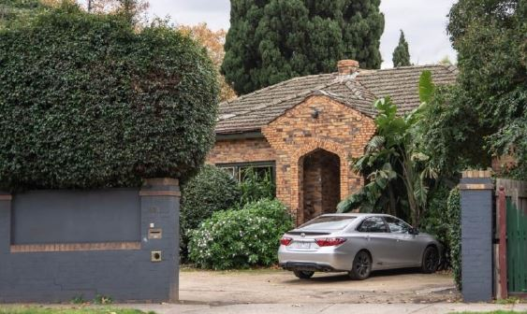
Houses

Slide 27
Proposed Planning Response – we want your feedback
Support More Local Jobs -
Economics and Land Use Study
Introduce Building Guidance and Controls - Built Form Framework
Protect Local Heritage - Heritage Study
Option to rezone industrial land to commercial zoning.
Option to introduce building height and overshadowing controls..
Option to protect heritage buildings through a heritage overlay.
Notes:
So in response to the LAP and background work, we have three main areas we’re focusing on – employment, built form and heritage – and I’ll talk through each of these now.
We did a survey of what people were most interested in for this session and all of these scored highly, so we’ll touch on each

Slide 28
Wrap Up & Next Steps
Late 2021
Darebin considers community feedback
Early 2022
Darebin prepares planning scheme amendment
Mid 2022
Darebin consults (exhibition) of proposed planning scheme amendment

Slide 29
Question
Time
Have your say on the proposed changes.
Respond to our Survey by visiting our yoursay page. Submission close at 3rd August 2021.
Visit our website at www.yoursaydarebin.com.au/heidelbergroadcorridor
Email us at planningservices@darebin.vic.gov.au
Call Dominique Aloisio on 8470 8025 or Sophie Jordan on 8470 8461
Notes:
Actions- Call to action for Council – same as project summary doc

Slide 30
Questions
How will heritage properties be protected so they remain visible along Heidelberg Road?
Will Fairfield Park be protected from overshadowing in all season? and Why is there no protection of zoning opposite Fairfield Park?
Will the Heidelberg Rd bike lane remain separated from traffic?
What is the position of Council on the planning of underground carparks that enter/ exit directly onto Heidelberg Rd and the bicycle lane?
Will Westgarth St be protected from this development or will developers be permitted to push back their high-rise onto Westgarth St and its bicycle lanes?
Why weren’t the owner of properties listed for the heritage overlay contacted directly by the project team?
Parking and traffic in side streets
Notes:
Actions- Call to action for Council – same as project summary doc

Slide 31
Questions

Slide 32
Notes:
Actions- Call to action for Council – same as project summary doc

Slide 33
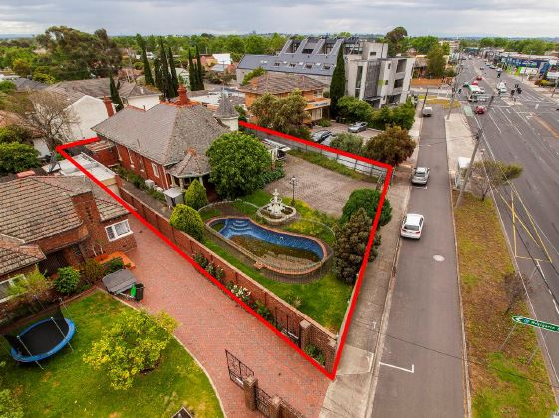
331-333 Heidelberg Road, Northcote
331-333 Heidelberg Road, Northcote.
A bird-eye view of 331-333 Heidelberg Road, Northcote.

Slide 34
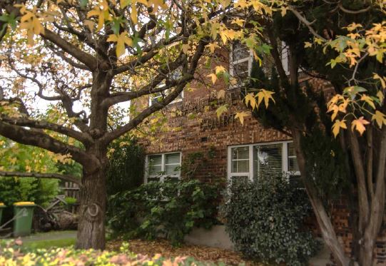
441 Heidelberg Road, Fairfield
East elevation of 441 Heidelberg Road, Fairfield.
South elevation of 441 Heidelberg Road, Fairfield.

Slide 35
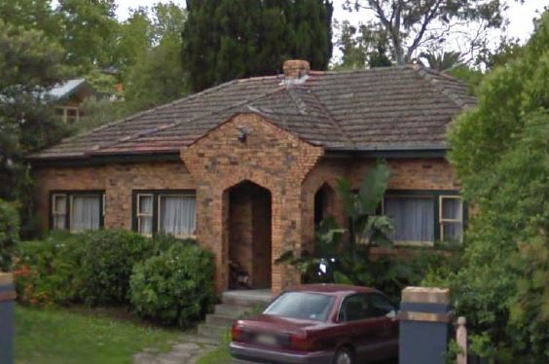
521 Heidelberg Road, Alphington
Southern elevation of 521 Heidelberg Road, Alphington.
Southern elevation of 521 Heidelberg Road, Alphington in 2009 showing fenestration and second portico opening.

Slide 36
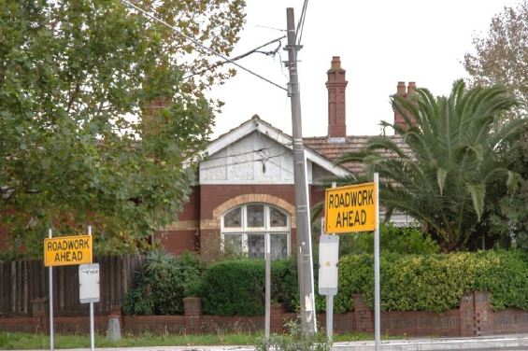
607 Heidelberg Road, Alphington
607 Heidelberg Road, Alphington.
607 Heidelberg Road, Alphington.

